Slide 1



Smart/Automate Irrigation
using soil moisture and weather data
By Donuru Sindhuja Reddy
AICTE Internship ID:INTERNSHIP_175040797468551b2636342
AICTE Student ID:STU6640c550046e51715520848

Slide 2

Learning Objectives
Understand how machine learning can assist in agriculture
Learn to use streamlit for deploying ML models
Analyze sensor data for intelligent irrigation
Build a simple and interactive prediction system
To build an intelligent sprinkler system that uses real-time sensor data to predict and automate irrigation efficiently.
GOAL
Source :
www.freepik.com/

Slide 3
Tools and Technology used
Python
streamlit
scikit-learn
joblib
numpy
CSV Data Handling

Slide 4
Methodology
Collected and preprocessed sensor data
Trained ML model using classification
Deployed model with Streamlit UI
Real-time predictions using sliders

Slide 5
Problem Statement:
Traditional irrigation methods waste water and are not optimized for crop needs. A smart solution is needed to reduce wastage and improve crop yields.

Slide 6
Solution:
We use a trained ML model that takes 20 scaled sensor inputs to predict whether each of 20 sprinklers should be ON or OFF.
Git link: https://github.com/sindhujareddy10/edunet

Slide 7
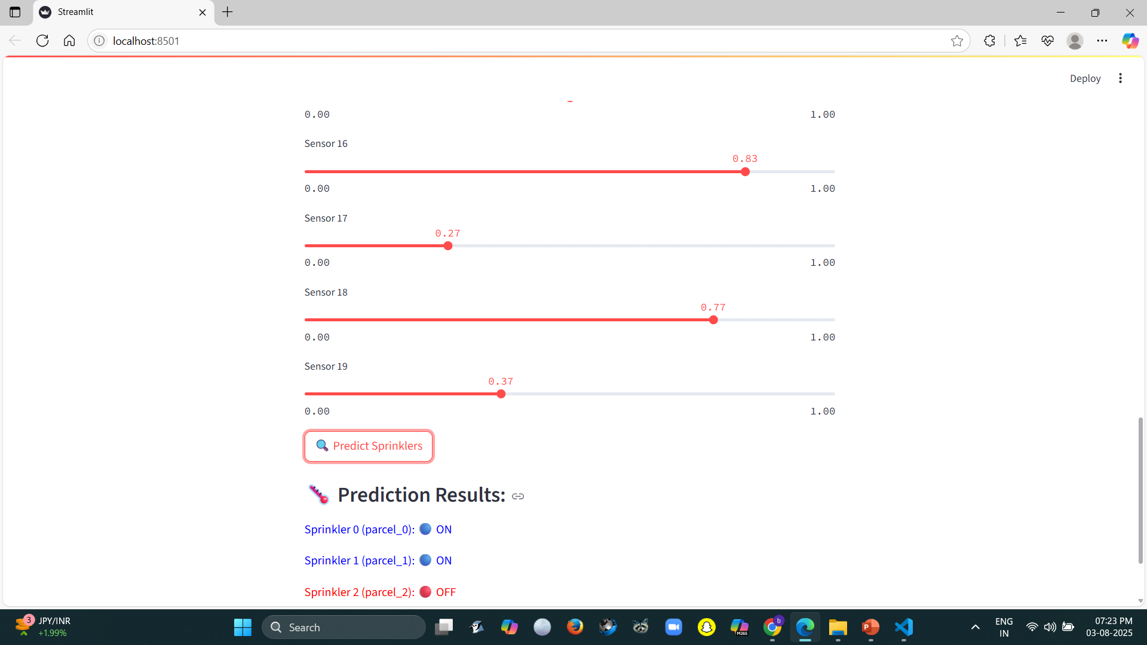
Screenshot of Output:

Slide 8
Conclusion:
This Smart Irrigation System demonstrates how machine learning and simple web interfaces can revolutionize agriculture by automating irrigation efficiently.

